Slide 1
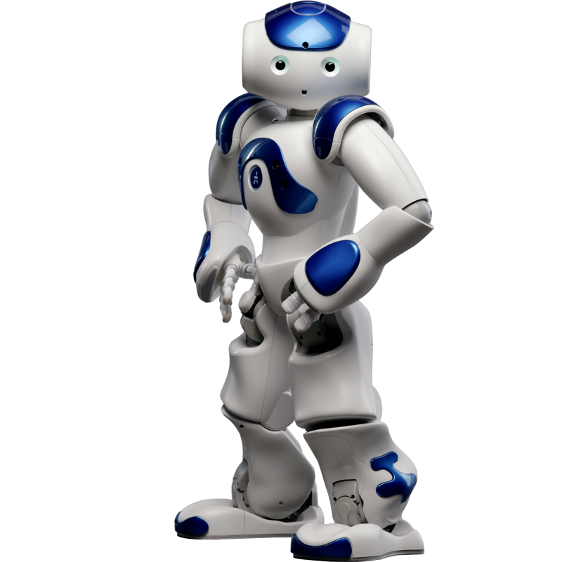
Humanoid Robot Dance Control over Real-Time Music Stimulation
Project Presentation for AU332
Jingwei(Victor) Zhao 517030910047
Zhengbao He 517030910157
Dec. 23, 2019
Notes:
Good morning, ladies and gentlemen. I’m Victor Zhao from Department of Automation.
In our project, we aim to implement a dance control system for humanoid robot over real-time music stimulation.

Slide 2
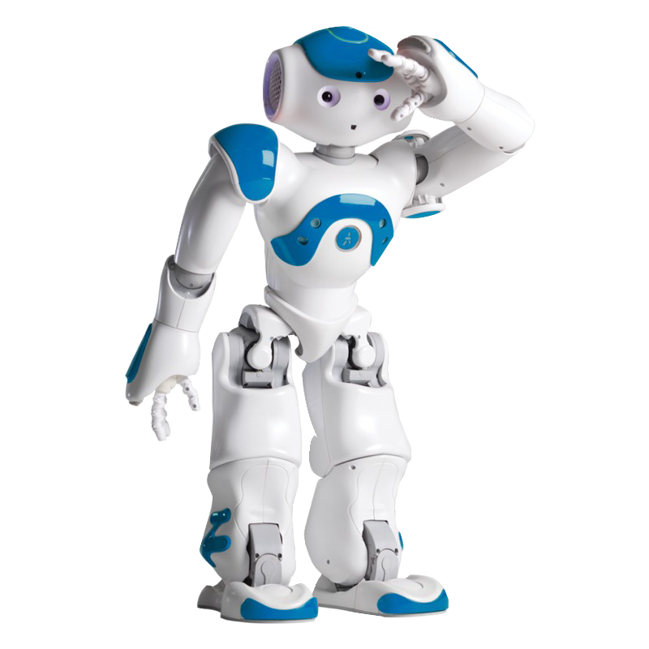




CONTENTS
Motivation
Related Work
Our Work
Future Work
Notes:
Now, I will guide you into our work through these four sections. It’s an interesting topic, actually, and I hope you enjoy it.

Slide 3
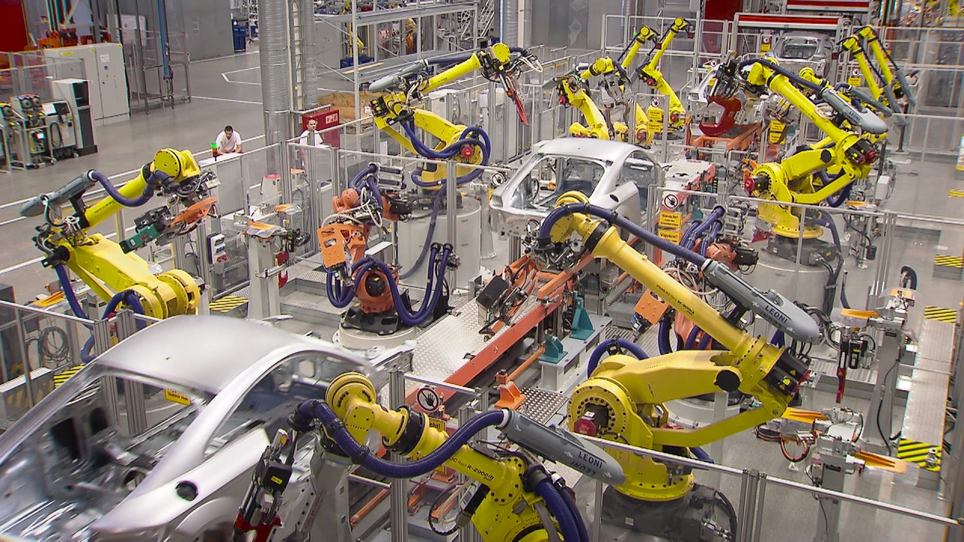
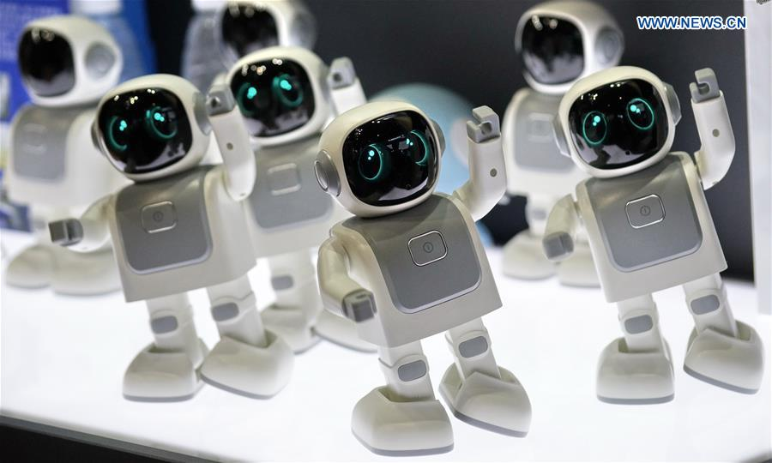
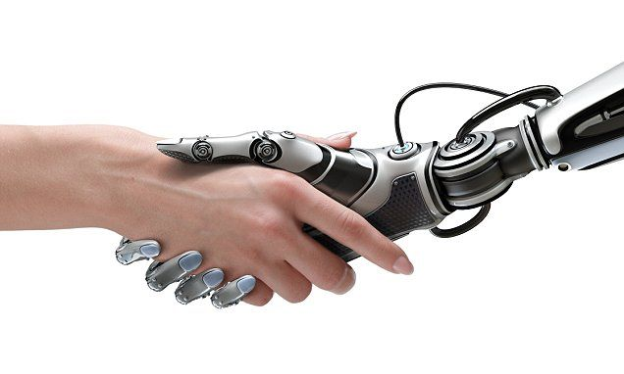
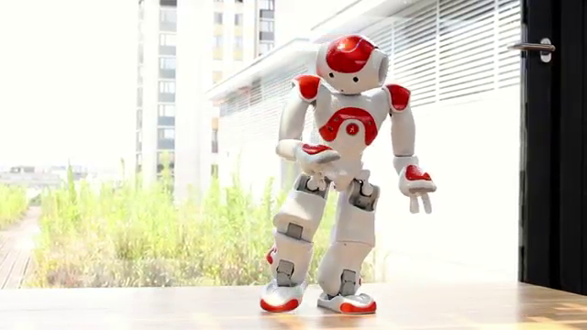
01. Motivation
Notes:
Traditionally, robots were designed to fulfill many industrial tasks.
However, the emergence of humanoid robots has led to many instances of robots imitating human activities.
Not surprisingly, dancing robots has become an actual field of research.

Slide 4
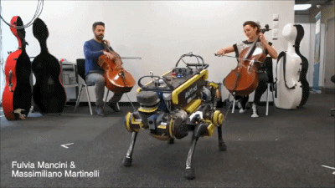
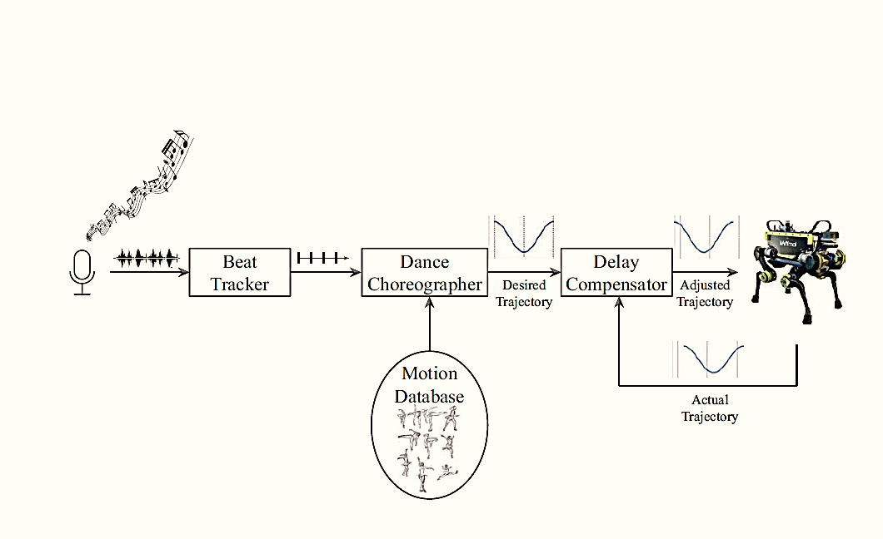
02. Related Work
Inspiration from ETH*
Real-time music stimulation (music beat tracking)
Non-programmed choreography
Motion-beat synchronization
Weakness
Pre-programed motion
Not a humanoid robot
*Bi, Thomas, et al. "Real-Time Dance Generation to Music for a Legged Robot." 2018 IEEE/RSJ International Conference on Intelligent Robots and Systems (IROS). IEEE, 2018.
Notes:
In this work from ETH, a real-time music stimulation is implemented with music beat tracking algorithms, thus the robot could actuate itself without pre-programed choreography.
However, it falls short in that, each dancing motion is still pre-programmed. We can’t rely on this method to let the robot dance many motions. What’s more, the robot here is not humanoid at all, and it dances just like that.

Slide 5
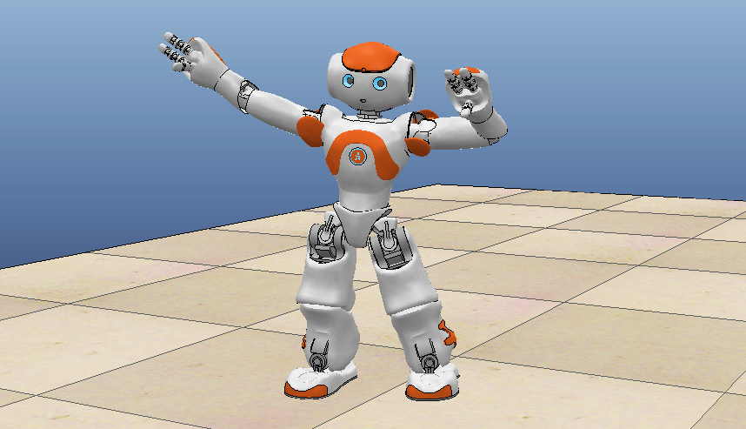
03. Our Work
Humanoid Robot Dance Control over Real-Time Music Stimulation
Robot we choose: Nao
Test virtual environment: CoppeliaSim (Vrep)
Technical Scheme:
Non-programmed motion
Stability for humanoid robot
Real-time music stimulation
Notes:
So, what we want, is to let a humanoid robot dance with real-time music.
Our technical scheme is three-folded. We wish our dancing motions to be non-programmed, while preventing the robot from falling down. Also, we follow the real-time music.

Slide 6
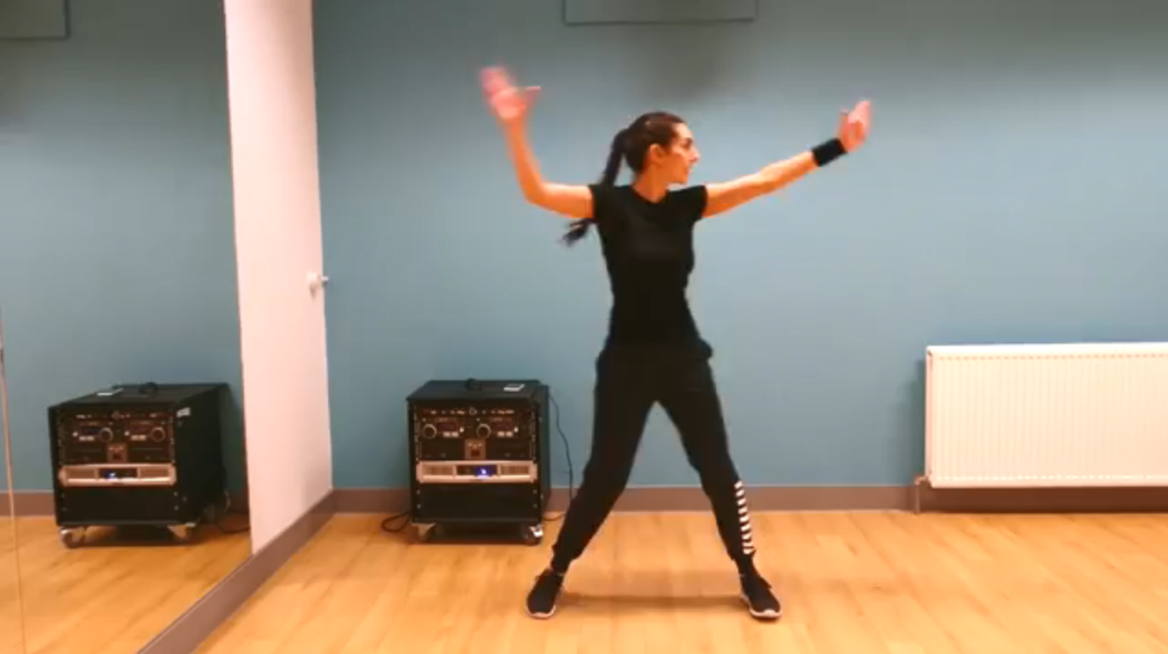
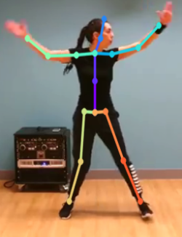
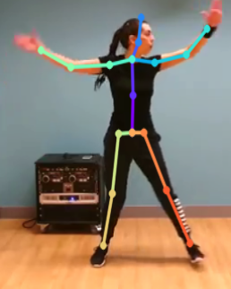
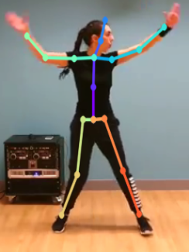
03. Our Work
Non-programmed motion? Learn from video!
3D Human Pose Estimation
Yolo v3*
PoseNet**
Video Stream
Set a motion base by extracting pose from a number of dance videos
*Redmon, Joseph, and Ali Farhadi. "Yolov3: An incremental improvement." arXiv preprint arXiv:1804.02767 (2018).
**Moon, Gyeongsik, Ju Yong Chang, and Kyoung Mu Lee. "Camera Distance-aware Top-down Approach for 3D Multi-person Pose Estimation from a Single RGB Image." Proceedings of the IEEE International Conference on Computer Vision. 2019.
Notes:
How to realize non-programmed dancing motions? Why not learn from videos?
We extract the dancer from each video frame with yolo,
and then estimate the 3D human pose with the PoseNet algorithm.
In this way, we get the dancer’s motion skeleton, imitating which, the robot just dances. This is where our innovation lies.

Slide 7
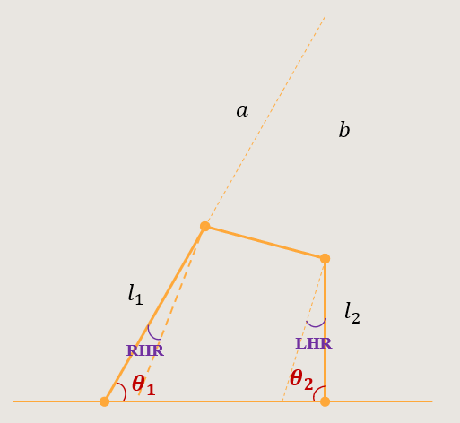
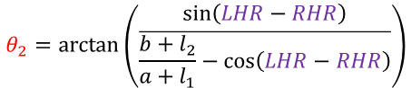
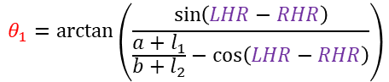
03. Our Work
Joint angel mapping & stability
Map pose joints to Nao joints
Keep feet parallel to the ground (approximately)
Specifically, we have:
$$θ_{1}=\arctan\left(\frac{\sin\left(LHR−RHR\right)}{\frac{a+l_{1}}{b+l_{2}}−\cos\left(LHR−RHR\right)}\right)$$
$$θ_{2}=\arctan\left(\begin{matrix}\sin\left(LHR−RHR\right) \\ \overline{\frac{b+l_{2}}{a+l_{1}}−\cos\left(LHR−RHR\right)}\end{matrix}\right)$$
In this way, we keep Nao stable in a static fashion
Notes:
Theoretically, each robot joint angel can be mapped from the 3d human pose, except the ankle joints, because such information is not recorded in the 3d human pose.
So we approximate and model the lower limbs, to keep the robot’s feet always parallel to the ground.
For example, in this situation, we get theta 1 and theta 2, thus we can control the ankle joints accordingly. In this way, we keep the robot stable in a static fashion.

Slide 8
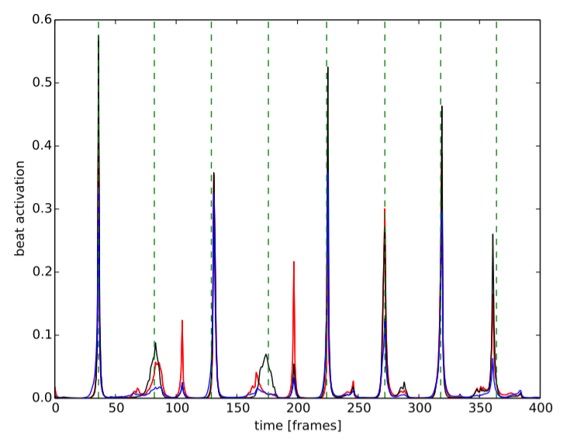
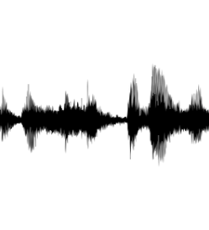
03. Our Work
Beat tracker
Take advantage of the python package ‘Madmom’,
which is designed for Music Information Retrieval
multi-model*
Rely on a PID controller to synchronize the motion with the beat
Stress the influence of time delay caused by calculation and data transmission
*Böck, Sebastian, Florian Krebs, and Gerhard Widmer. "A Multi-model Approach to Beat Tracking Considering Heterogeneous Music Styles." ISMIR. 2014.
Notes:
As for the music part, we follow the ETH paper, and take advantage of the madmom package to extract real-time music.
We also implement a PID controller to synchronize the dancing motion with the beat tightly.

Slide 9
03. Our Work
Overall Diagram
Motion Selector Select motion from the motion base based on a Markov Chain
Speed Controller Control the time delay between adjacent motion frames, to keep track of the beat
Implemented in a multi-process way
Beat Extractor Extract beat sequence from real-time music
Motion Actuator Actuate the robot joint angelsin the environment with calculated values
Notes:
Finally, this is an overall glance of the system we build. It consists of four components: beat extractor, motion selector, speed controller, and motion actuator.
The whole system combines them in a multi-process fashion in order to decrease time delay. This is extremely important for real-time control.

Slide 10
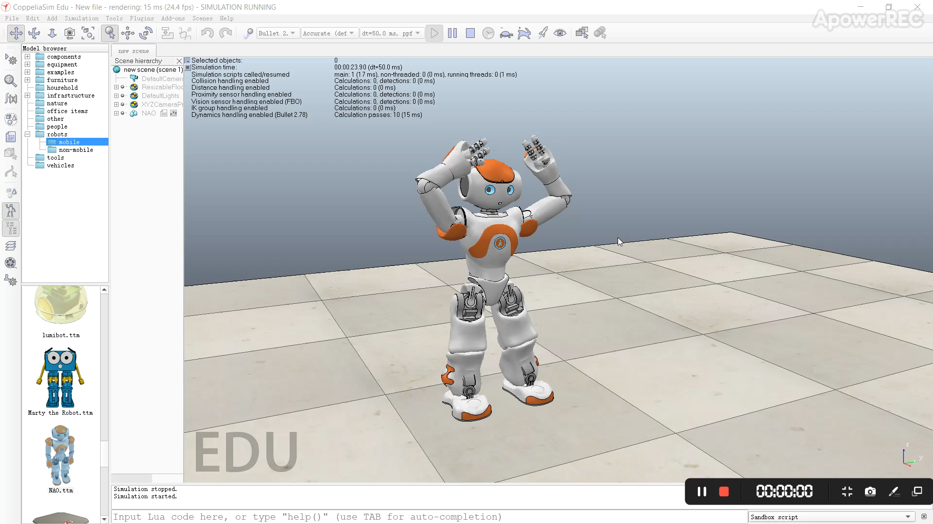
03. Our Work
Demo Video
Notes:
Here is the results of our work.
The robot is ready, and we start the program.
Basically, you can see that the dancing motions follow the beats.

Slide 11
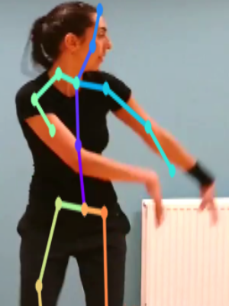
04. Future Work
Contribution
Non-programmed dance motion implemented by 3D human pose estimation
A practical method to keep the stability of a humanoid robot when dancing
Weakness
High-speed-with-low-rate problem
Static stability is not reasonable
Future Work
Try out more human pose estimators
Keep stability of the robot with Reinforcement Learning
Utilize more information from the music, e.g., emotion
Move the algorithms to a real humanoid robot
Notes:
Our contribution in this work lies in the non-programmed motion and stability control method. However, we haven’t explore either of them optimally, and that’s where our weakness lies.
To realize better performance, we still have a bunch of future work to do. Hopefully, we will move all our implementations to the real robot.

Slide 12
Thanks!
Questions?
Contact: zhaojw@sjtu.edu.cn
WeChat: zjw-1430253126
Notes:
So, that’s all for now. Thank you!
Any questions?
If you have any related topics to discuss, please feel free to contact me.

